Slide 1






Enhanced environmental protection inspection for efficient control of air quality monitoring and of all entities under obligation within system of greenhouse gas emission allowance trading, in order to achieve better quality of air in Republic of Croatia
This project is funded by the European Union

Slide 2



THEME 1: The pollution of the atmosphere
Energy Research and Environmental Protection Institute

Slide 3


1.1 HISTORICAL OVERVIEW-introduction
European Union IPA 2013 Programme for Croatia
The air we breathe is an essential natural resource on which depends the life on Earth. Clean air is a prerequisite for a healthy life of humans, animals and plants, but unfortunately, the development of the industry, continually pollutes. So polluted air, depending on the concentrations of pollutants in it, more or less has a direct harmful effects on the health of all living beings on our planet. Also directly and indirectly affect the pollution of water and soil.

Slide 4
1.1 HISTORICAL OVERVIEW-introduction
European Union IPA 2013 Programme for Croatia
So that we can act successfully on the reduction of the negative impacts of air pollution, we must be familiar with the basic facts related to the chemical characteristics of the formation, and the time and the spatial distribution of pollutants. So that we can assess the risk that represents the contaminated atmosphere it is necessary to study the toxicological, epidemiological and public health consequences that may be causing the problem. We could all of the above we need data on the levels of pollution of the atmosphere. They are obtained by continuous, reliable and harmonised measurements of the concentrations of the pollutants in the air as the most commonly refer to as MONITORING air quality.

Slide 5
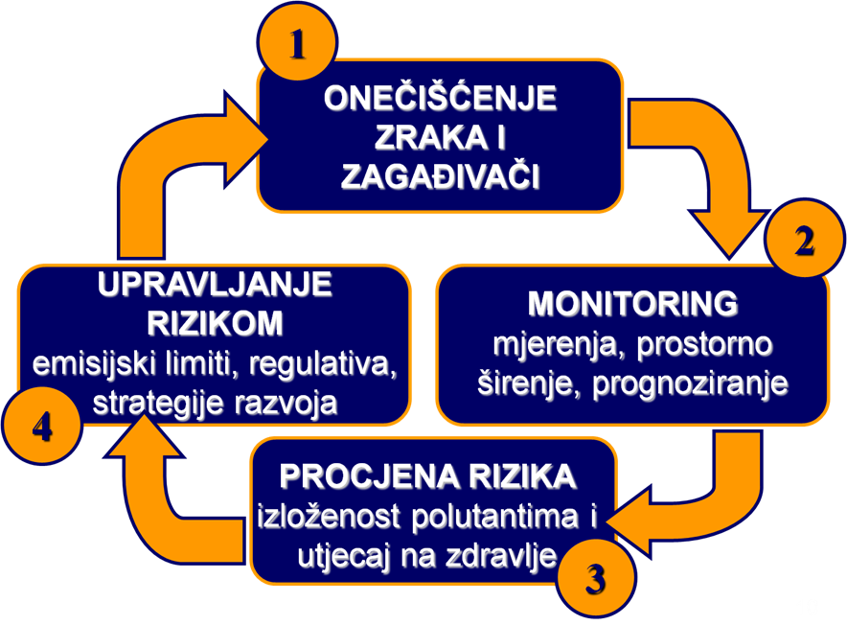
1.1 HISTORICAL OVERVIEW-introduction
European Union IPA 2013 Programme for Croatia
AIR POLLUTION AND POLLUTANTS
RISK MANAGEMENT
the emission limits, regulation, strategy development
MONITORING measurement, spatial expansion, forecasting
RISK ASSESSMENT the exposure to environmental contaminants and health impacts

Slide 6
1.1 HISTORICAL OVERVIEW
European Union IPA 2013 Programme for Croatia
Pollution of the atmosphere has been identified by the World Health Organization (WHO) as the greatest risk to the environment and human health.
The WHO estimates that pollution of the atmosphere only in 2012. caused 6 million premature deaths around the world.

Slide 7
1.1 HISTORICAL OVERVIEW
European Union IPA 2013 Programme for Croatia
HOW DO WE COME TO THESE CONCLUSIONS?
UNFORTUNATELY THE HARD WAY-THROUGH EXPERIENCE GAINED IN MAJOR EPISODES OF AIR POLLUTION THROUGH HISTORY.

Slide 8
1.1 HISTORICAL OVERVIEW
European Union IPA 2013 Programme for Croatia
YEAR | PLACE | STATE | POLLUTANT | CONSEQUENCES
1873. | LONDON | UK | SO₂, SMOKE | 5000 DEATHS
1880. | LONDON | UK | SO₂, SMOKE | 1000 DEATHS
1892. DECEMBER | LONDON | UK | SO₂, SMOKE | 1000 DEATHS
1930. DECEMBER | MEUSSE VALLEY | BELGIUM | FLUORINE | 60 DEATHS
1948. OCTOBER | DONORA | PENNSYLVANIA | DIOXINS | 20 DEATHS, 7000 HOSPITALIZED
1950. NOVEMBER | POZA RICA | MEXICO | H₂S | 22 DEATHS, 320 HOSPITALIZED
1952. DECEMBER | LONDON | UK | SO₂, SMOKE | 4703 DEATHS
1976. JULY | SEVESO | ITALY | DIOXINS | UNKNOWN
1984. DECEMBER | BHOPAL | INDIA | MIC | 2000 DEATHS, 300 000 HOSPITALIZED

Slide 9
1.1 HISTORICAL OVERVIEW
European Union IPA 2013 Programme for Croatia
Great episodes of pollution atmosphere with disastrous consequences in the history they had natural and anthropogenic origin. The concentration of pollutants in the air except that depend on the place and the source of emissions, depend on the state of the atmosphere.
Three meteorological parameters that have the greatest impact on the atmospheric transport and dispersion of pollutants are:
WIND DIRECTION
WIND SPEED
THE STABILITY OF THE ATMOSPHERE

Slide 10
1.1 HISTORICAL OVERVIEW
European Union IPA 2013 Programme for Croatia
THE MOST FAVORABLE CONDITIONS FOR THE RETENTION OF POLLUTANTS IN THE AIR WITHOUT THE POSSIBILITY OF DISPERSION, WHICH ARE FOUND IN ALL THE GREAT EPISODES OF POLLUTION OF THE ATMOSPHERE ARE:
Stable atmosphere, without the wind flow, with the advent of temperature inversion, and clouds.
The stability of the atmosphere is a measure for air turbulence, and it represents the vertical atmospheric temperature profile.

Slide 11
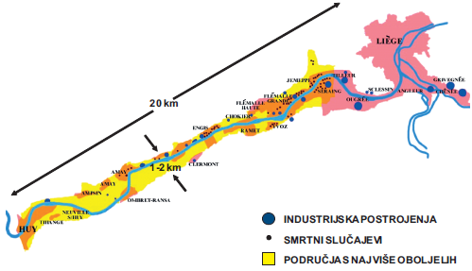
European Union IPA 2013 Programme for Croatia
1.1 HISTORICAL OVERVIEW
Valley of the river Meuse (Belgium), 1930.
Time: 3 to 5 December 1930.
Meteorological conditions: the daily temp. a little above 0 ° C, night -10 ° C, without the wind, the fog.
Category: industry (27-factory of the ironworks, the manufacture of glass and ceramic, zinc and phosphate). Population: thick.
The mist: large concentration fluorine in tetrafluorosilan compounds (SiF₄) and hydrogen fluoride (HF), the great concentration (SO₂), sulphuric acid (H₂SO₄), carbon monoxide (CO) and particulate. Consequences: 60 people have died of suffocation fluoride, several thousand patients. Symptoms: difficulty breathing, astmatic attacks, cough, rapid pulse, neurological outbursts, vomiting.

Slide 12
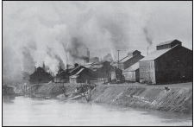
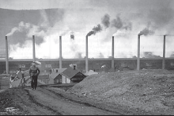
1.1 HISTORICAL OVERVIEW
European Union IPA 2013 Programme for Croatia
Donora (Pennsylvania), 1948.
Time: 24 October 1948.
Meteorological conditions: a temperature inversion at night, stable atmosphere, without the wind, the fog. Category: industry (steelworks and drives for the production of sulfuric acid). Population: thick.
The mist: large concentration of (SO₂) and sulfuric acid (H₂SO₄) which led to the formation of acidic smog. Large concentration carbon monoxide (CO) and metallic particles. Consequences: 20 people died of suffocation, 7000 hospitalized at the age of 52 to 85 years of age. Symptoms: difficulty breathing, asthmatic attacks, cough, rapid pulse.

Slide 13
1.1 HISTORICAL OVERVIEW
European Union IPA 2013 Programme for Croatia
Poza Rica (Mexico), 1950.
Time: November 1950.
Meteorological conditions: air temperature is low, the temperature inversion, a breeze.
Activity: oil wells. AN INDUSTRIAL ACCIDENT.
Population: thick.
Air: Releasing large amounts of unburned hydrogen sulfide (H₂S) from the oil wells. The breeze is gas transported along the Earth's surface in the direction of the residential part of the city. Consequences: 22 people have died, 320 hospitalized because of pollution poisoning.

Slide 14
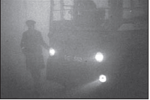
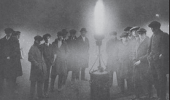
1.1 HISTORICAL OVERVIEW
European Union IPA 2013 Programme for Croatia
London (UK), 1952.
Time: 5-8 December 1952.
Weather conditions: very low air temperatures, a temperature inversion at night, stable atmosphere without the vertical mixing of the air, the fog and smog.
Population: thick, increased heating homes combustion engines large amounts of coal.
Air: During 4 days has been measured 56 times the concentration of particles in the air than the usual value concentration. SO₂ was 7 times higher than the highest value ever recorded.
Consequences: 4703 persons died in the next week, 8000 deaths in the coming months from the effects of inhaling polluted air.

Slide 15
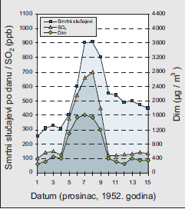
1.1 HISTORICAL OVERVIEW
European Union IPA 2013 Programme for Croatia
London (UK), 1952. (con.)
Figure 1.
The number of deaths in correlation with elevated concentration (SO₂) and smoke. It is necessary to pay attention to the sudden increase in all the values 5 December, then at the peak of the values 7 and 8 December and the decline of all values after 8 December.

Slide 16
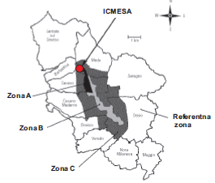
1.1 HISTORICAL OVERVIEW
European Union IPA 2013 Programme for Croatia
Seveso (Italy), 1976.
Time: July 1, 1976.
Meteorological conditions: windy Activities: chemical industry (the company ICMESA). AN INDUSTRIAL ACCIDENT. Population: thick.
Air: the reactor after the explosion of the chemical industry developed by the toxic cloud that contained a high concentration of dioxin 2, 3, 7, 8, tetrachloro-dibenzo-para-dioxin (TCDD). Undergrowth is cloud contaminated an area the length of 6 km and a width of 1 km of the consequences: an unknown number of sufferers.
Accident encouraged the passing of Seveso directive (Directive 82/501/EEC)-legal regulations on security in the industrial areas and security measures.

Slide 17
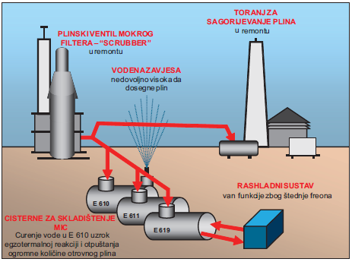
1.1 HISTORICAL OVERVIEW
European Union IPA 2013 Programme for Croatia
Bhopal (India), 1984.
Time: December 3, 1984.
Activity: manufacture of pesticides (company UCIL). AN INDUSTRIAL ACCIDENT.
Population: very dense.
Air: the atmosphere is omitted, 15 metric tons of (MIC), which covered an area of 78 km². The accident happened due to the leakage of water in the tank E610, which is in egzothermic reaction with MIC caused the release of massive amounts of poison gas. That's contributed to a series of failures on the plants and tankers for storage. Security systems were out of service because of the savings in the production of (cooling system). Gas valve wet filter and a tower for the combustion of gas were on an overhaul, and water spray was not sufficiently high to reach the height of the released gas. Consequences: 4 000 people died immediately, 15 000 died in the next few years, 500 000 affected from lung edema, and 100 000 today very sick.

Slide 18
1.1 HISTORICAL OVERVIEW
European Union IPA 2013 Programme for Croatia
The consequences of pollution atmosphere of catastrophic proportions
Air pollution is a big public health problem
Each accidental situation, leaves behind the victims of fatal cases and/or diseases of environmental pollution
In spite of the developed methods for the control of air pollution, much of it still needs to be taken to increase security

Slide 19
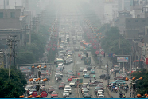
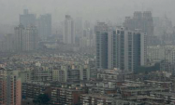
1.1 HISTORICAL OVERVIEW
European Union IPA 2013 Programme for Croatia
10 the most polluted places in the world
A Blacksmith Institute, in cooperation with a Swiss Green Cross has assembled a list of 10 the most polluted places in the world
Linfen, China
The number of endangered inhabitants: 3 000 000 Contaminated medium: air pollutant
Type: coal and floating particles
Source : emissions from industry and traffic
2. Tianying, China
The number of vulnerable population: 140 000 Contaminated medium: air, soil and water
Type: lead and other heavy metals pollution Source : mining and industry

Slide 20
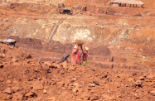
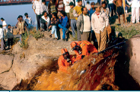
1.1 HISTORICAL OVERVIEW
European Union IPA 2013 Programme for Croatia
10 the most polluted places in the world
3. Sukinda, India
The number of endangered inhabitants: 2 600 000 Contaminated medium: air, soil and water
Type: more chrome and other metals
Source: mining
4. Vapi, India
The number of vulnerable population: 71 000 Contaminated medium: air, soil and water
Type: pesticides, PCB, chlorine and heavy metals Source: industry

Slide 21
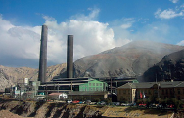
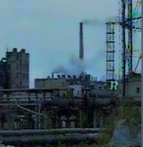
1.1 HISTORICAL OVERVIEW
European Union IPA 2013 Programme for Croatia
10 the most polluted places in the world
5. La Oroya, Peru
The number of vulnerable population: 35 000 Contaminated medium: air, soil and water
Type: sulphur dioxide, lead, copper and zinc
Source: industry
6. Dzerzhinsk, Russia
(according to the Guinness Book of world records the most polluted city in the world)
The number of endangered inhabitants: 300 000 Contaminated medium: air, soil, water,
Type: dioxins, phenol, sarin, VX gas, the lead
Source: chemical industry of battle poison

Slide 22
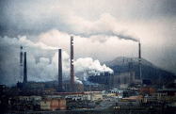
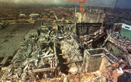
1.1 HISTORICAL OVERVIEW
European Union IPA 2013 Programme for Croatia
10 the most polluted places in the world
7. Norilsk, Russia
The number of vulnerable population: 134 000 Contaminated medium: air
Type: floating particles, sulphur dioxide, heavy metals, hydrogen sulphide and phenols
Source: mining and processing of metals
8. the Chernobyl, Ukraine
The number of endangered inhabitants: 5 500 000 Contaminated medium: air, soil, water,
Type: the radiation
Source: nuclear power plant

Slide 23
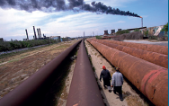
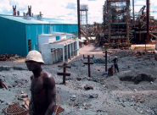
1.1 HISTORICAL OVERVIEW
European Union IPA 2013 Programme for Croatia
10 the most polluted places in the world
9. Sumgayit, Azerbaijan
The number of endangered inhabitants: 275 000
Contaminated medium: air
Type: organic compounds, oils and heavy metals, in particular mercury
Source: petrochemical industry
10. Kabwe, Zambia
The number of vulnerable population: 255 000
Contaminated medium: air, soil, water,
Type: lead and cadmium
Source: mines and processing of lead

Slide 24
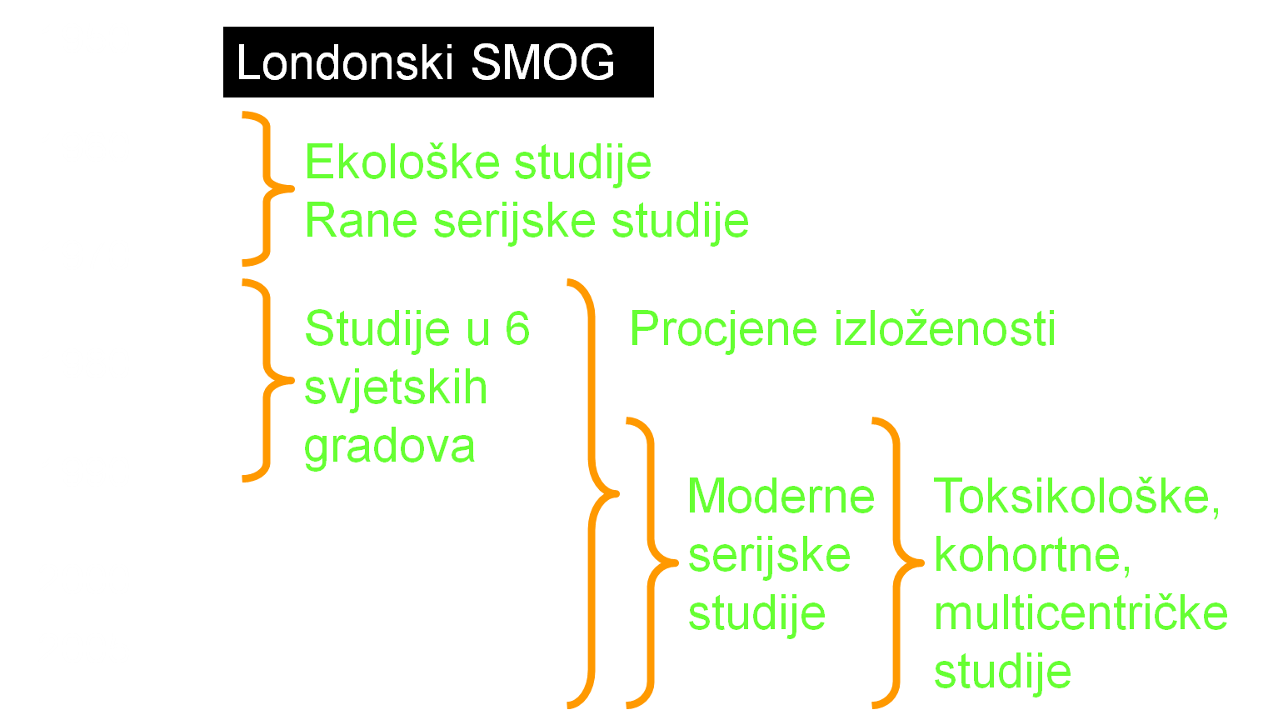
1.1 HISTORICAL OVERVIEW
European Union IPA 2013 Programme for Croatia
60 + years of research in the field of air pollution
Ecological studies
Early series studies
Studies in 6 world cities
Exposure estimates
Modern series studies
Toxicological, cohort, multicentric studies

Slide 25
1.2 AIR QUALITY MANAGEMENT: monitoring-risk assessment-risk management
European Union IPA 2013 Programme for Croatia
AIR POLLUTION AND POLLUTANTS
RISK MANAGEMENT
the emission limits, regulation, strategy development
MONITORING measurement, spatial expansion, forecasting
RISK ASSESSMENT the exposure to environmental contaminants and health impacts
Figure 2. The management of air quality. Source: created by author.

Slide 26
1.2 AIR QUALITY MANAGEMENT: monitoring-risk assessment-risk management
European Union IPA 2013 Programme for Croatia
Monitoring
Monitoring is organised by setting up a network of measuring devices that continuously measure and record the concentrations of pollutants in a certain area at a certain time, and it's for exactly defined way, resulting in the possibility of comparing the results of measurements in everywhere world.
In this way, it gets to be an insight into the state of air pollution, given the measured pollutants in a certain area.
This knowledge, other than what they are used for regulatory purposes (evaluation of air quality with regard to limit values), continue to be used in the management of air quality.

Slide 27
1.2 AIR QUALITY MANAGEMENT: monitoring-risk assessment-risk management
European Union IPA 2013 Programme for Croatia
Risk assessment
Exposure to polluted air can adversely affect human health. These effects will depend on the type of pollution with respect to:
pollutants,
the concentration of pollutants,
the duration of exposure to environmental contaminants,
the sensitivity of each individual or group.

Slide 28
1.2 AIR QUALITY MANAGEMENT: monitoring-risk assessment-risk management
European Union IPA 2013 Programme for Croatia
Risk assessment (continued)
The World Health Organization in its report "the WHO air quality guidelines for Europe" in annex 1.1 extensively and documented the negative effects of health provides an overview of the caused by contaminated air.
These effects can be described concisely in a pyramid whose base are the most common and most widely prevalent effects until it is towards the top of the pyramids appear less represented, but tends to negative impacts on health (Figure 3).

Slide 29
1.2 AIR QUALITY MANAGEMENT: monitoring-risk assessment-risk management
European Union IPA 2013 Programme for Croatia
Risk assessment (continued)
Increasing mortality
Figure 3. The pyramid of health effects of contaminated air. Source: "the WHO air quality guidelines for Europe".
Increasing hospitalization
Increased emergency response
Increased drug consumption
Other respiratory symptoms
Asthma attacks
reduction of pulmonary function
Subclinic effects

Slide 30
1.2 AIR QUALITY MANAGEMENT: monitoring-risk assessment-risk management
European Union IPA 2013 Programme for Croatia
Risk management
Reduction of exposure by polluted air, and thus the risk of the adverse effect on health, can be achieved in two ways:
the reduction of pollution (reducing emissions of pollutants),
separation of the sources of pollution of residential space in which people spend the most time.

Slide 31
1.2 AIR QUALITY MANAGEMENT: monitoring-risk assessment-risk management
European Union IPA 2013 Programme for Croatia
Risk management (continued)
Reduction of emissions into the air is carried out by the introduction of new and more effective technologies in existing pollutants and banning the construction of new pollutants that will serve the old and inefficient technologies.
The best instrument for the implementation of such measures is the most common regulations. Legislation in the areas of air quality are exactly the prescribed quantities of pollutants that certain types of pollutants allowed to let in air. Also the regulations as a condition of the construction of the new pollutants sets the necessity of the use of the best available technology with regard to environmental pollution.

Slide 32
1.2 AIR QUALITY MANAGEMENT: monitoring-risk assessment-risk management
European Union IPA 2013 Programme for Croatia
Risk management (continued)
For example, without the high-quality and scientifically based study that assesses the impact of the new pollutants on the environment could not start the process of the construction of the same.

Slide 33
1.2 AIR QUALITY MANAGEMENT: monitoring-risk assessment-risk management
European Union IPA 2013 Programme for Croatia
Risk management (continued)
2. reducing exposure to separation of the sources of pollution and residential space is a very effective method, but requires a very serious approach to the urbanization and the development of society in general. Unfortunately, this method is difficult to apply to already existing problematic zones.
Well known are the problems of housing settlements in industrial zones. Yet from such examples such as settlements in the vicinity of the refinery and ironworks in Sisak, or artificial fertilizers factory in Kutina is necessary to draw lessons for future urban planning and development.

Slide 34
1.2 AIR QUALITY MANAGEMENT: monitoring-risk assessment-risk management
European Union IPA 2013 Programme for Croatia
Risk management (continued)
The biggest problem in the application of these methods constitutes a reduction in emissions from motor vehicles, since the use of the vehicle closely associated with people's places of residence. A solution to this problem is closely connected with some very unpopular measures to which they who decide are reluctant to make decisions, so it is a problem in most cases, lengthy and intractable.
By raising the awareness of citizens about the problem in a reasonable period of time may lead to acceptance and of such measures.

Slide 35
1.2 AIR QUALITY MANAGEMENT: monitoring-risk assessment-risk management
European Union IPA 2013 Programme for Croatia
Risk management (continued)
The implementation of measures to reduce health risks caused by air pollution leads to the need for re-determination of the effects of these measures.
That, of course, can do well enough the only monitoring air quality.
So once again came up with the first components of the air quality management system: the process for the protection of human health and the environment takes place continuously. A similar principle applies in other BOMs of the environment which represents the backbone of the sustainable development of human civilization on our planet.

Slide 36
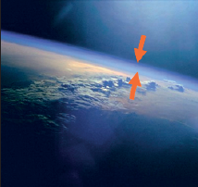
1.3 ATMOSPHERE
European Union IPA 2013 Programme for Croatia
The atmosphere (from GK. atmos and sfaira ) is a gaseous layer of the planet Earth.
Due to Earth's gravity that attracts an atmosphere, she has a shape similar to the shape of the Earth and along with it participates in the processes of rotation (the rotation of the earth around its imaginary axis) and the revolution (revolution of the earth around the Sun), which is reflected in daily and annual changes of the atmosphere.
Satellite image of the Earth with the atmosphere-Earth's atmosphere is a layer of blue along the surface of the Earth is marked by the arrow. Source: NASA.

Slide 37
1.3 ATMOSPHERE
European Union IPA 2013 Programme for Croatia
Atmospheric air is a mixture of various gases, chemical compounds, and gaseous, liquid and solid supplements.
Atmospheric gases are divided into two groups:
the permanent components
the variable components
Although the nitrogen and oxygen essential for life on Earth, they have almost no impact on atmospheric processes. The atmosphere, which consists only of the fixed components, without water vapor and various other solid and liquid wastes, is referred to as dry air.

Slide 38
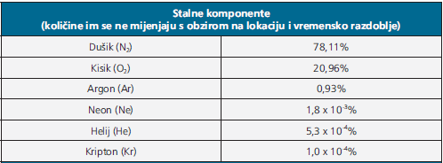
1.3 ATMOSPHERE
European Union IPA 2013 Programme for Croatia
Permanent components

Slide 39
1.3 ATMOSPHERE
European Union IPA 2013 Programme for Croatia
Variable components of atmospheric air that are in it are found in low concentrations or in trace amounts, have a much higher impact on short-term weather changes and long-term climate change.
Example:
Change of the concentration of water vapor in the atmosphere affects the relative humidity of the air: water vapor, CO₂, CH₄ and N₂O natural phenomena called the "greenhouse effect" allows life on earth because without them the temperature on the Earth's surface was up to 30 ° C lower.

Slide 40
1.3 ATMOSPHERE
European Union IPA 2013 Programme for Croatia
The proportion of water vapor in the atmosphere of fluctuating from 0% at very low temperatures in the polar ends of up to 4% at high temperatures in the tropics.
In addition to the temperature, the amount of water vapour depends on the distance from the source of moisture. The amount of water vapour decreases with increasing altitude, for example. in temperate latitudes, when the surface has about 1.3% water vapour in unit volume of air, at a height of 1 km, the share drops to 1.01%, 3 km to about 0.5%, while 8 km altitude water vapor has only 0.03%.

Slide 41
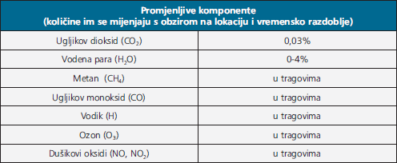
1.3 ATMOSPHERE
European Union IPA 2013 Programme for Croatia
Variable components
In traces
In traces
In traces
In traces
In traces

Slide 42
1.3 ATMOSPHERE
European Union IPA 2013 Programme for Croatia
Although the permanent components of the air today almost do not change, in the long geological past that goes back to 4.6 billion years ago have experienced dramatic changes.
It is assumed that the then «ancient» the atmosphere consisted of nitrogen and carbon dioxide, with small amounts of oxygen.
The concentration of oxygen in the atmosphere began to increase about 3.5 billion years ago together with the bacteria which have had the ability of photosynthesis and are in the process, it began to produce. Since then, the proportion of oxygen in the atmosphere began to rise to today's 21%.

Slide 43
1.3 ATMOSPHERE
European Union IPA 2013 Programme for Croatia
The vertical structure of the atmosphere it is very complex. On the individual sections of the layers can be divided according to different criteria.
The atmosphere can be divided in relation to the thermal properties of the individual parts, and also on the basis of the degree of ionization, IE. electrical conductivity of individual layers.

Slide 44
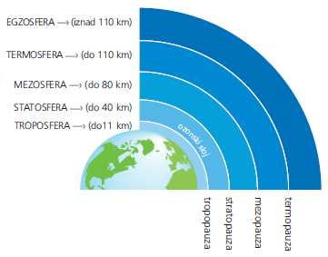
1.3 ATMOSPHERE
European Union IPA 2013 Programme for Croatia
The division of the atmosphere according to the temperature differences
The thickness of the vertical layers of the atmosphere measuring from the surface of the Earth is not exactly certain, but it is assumed that costs more than 800 km, and then moves into interplanetary space. The atmosphere is in a vertical column, divided into 5 layers of different physical and chemical properties.
Schematic view layers and border layers of Earth's atmosphere.

Slide 45
1.3 ATMOSPHERE
European Union IPA 2013 Programme for Croatia
Troposphere
Troposphere is located along the Earth's surface and along with tropopause is called the lower atmosphere. Has a different weight depending on the latitude. At the equator is the thickest (16 to 18 km), above moderate geographic width fat is about 11 km, and above the poles of from 8 to 10 km. It is the densest layer of the atmosphere and covers 90% of the total atmospheric mass. In this layer are happening all meteorological processes. Since it contains nearly all of the water vapor in the atmosphere, the troposphere, the clouds are created that give precipitation. The concentration of water vapor is the highest over the equator, and the lowest over the poles.

Slide 46
1.3 ATMOSPHERE
European Union IPA 2013 Programme for Croatia
Stratosphere
The stratosphere extends from the upper limit of the troposphere up to 40 km altitude. This layer is characterized by a large amount of ozone, which at a height of 20 to 25 km makes the ozone layer that surrounds the Earth. The ozone layer absorbs ultraviolet rays emitted from the Sun and warms the layers of air. The air in the stratosphere is less common than the air in the troposphere, it has a little tinge of, and especially very little water vapor, so there's no precipitation.

Slide 47
1.3 ATMOSPHERE
European Union IPA 2013 Programme for Croatia
Mesosphere
This layer builds on the stratosphere and spreads in the amount of 40 to 80 km, along with stratosphere, stratopause and mezopause is called a secondary atmosphere.
Thermosphere
Thermosphere is part of the Earth's atmosphere, which extends from 80 to 110 km and is known as the upper atmosphere. There there is no ionising radiation. Present of low wave UV-rays, X-rays and cosmic rays possess a sufficient energy for the ionization molecules and disotiate them to their component parts. Therefore, this layer consists of many ions, free electrons and protons (plasma).

Slide 48
1.3 ATMOSPHERE
European Union IPA 2013 Programme for Croatia
Exosphere
Exosphere is a layer of Earth's atmosphere that is located above the thermosphere. Its limit is not specific, but it is assumed that extends up to 1000 km above the Earth's surface. In it are the atoms and ions in the air so diluted and they have great speed so that one part of the particle of light gases such as hydrogen and helium overcomes earth's gravity and goes into outer space.

Slide 49
1.3 ATMOSPHERE
European Union IPA 2013 Programme for Croatia
The pressure in the atmosphere
Atmospheric pressure is defined as the force with which the weight of the column of the atmosphere acts on a unit horizontal surface.
Atmospheric pressure decreases exponentially with increasing altitude. The cause for this is that the number of molecules of air decreases with height.
Example:
On the sea level atmospheric pressure varies between 960 and 1050 mb (millibars), with an average value of 1013 mb, while on the top of Mt. Everest is only 300 mb.

Slide 50
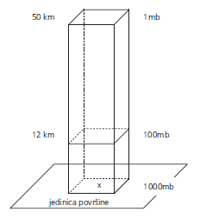
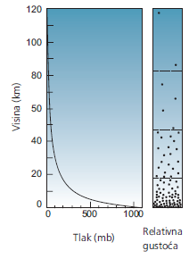
1.3 ATMOSPHERE
European Union IPA 2013 Programme for Croatia
The pressure in the atmosphere (continued)
Atmospheric pressure on different heights.
Relationship between atmospheric pressure, altitude and density of the atmosphere.

Slide 51

1.3 ATMOSPHERE
European Union IPA 2013 Programme for Croatia
Units for measuring atmospheric pressure
The unit for the measurement of atmospheric pressure, the most commonly used are: the millimeter of mercury (mmHg) atmosphere (atm) hectopaskal (hPa) milibar (mb)
The relationship between the unit for pressure measurement

Slide 52
THANK YOU FOR YOUR ATTENTION !
Disclaimer: The contents of this publication are the sole responsibility of EKONERG – Energy Research and Environmental Protection Institute, Ltd. and can in no way be taken to reflect the views of the European Union
This project is funded by the European Union

